Slide 1

Chapter 10
Error Detection and Correction
10.‹#›
Copyright © The McGraw-Hill Companies, Inc. Permission required for reproduction or display.
Notes:
‹#›

Slide 2

Note
Data can be corrupted during transmission.
Some applications require that errors be detected and corrected.
10.‹#›
Notes:
‹#›

Slide 3
10-1 INTRODUCTION
Let us first discuss some issues related, directly or indirectly, to error detection and correction.
Topics discussed in this section:
Types of Errors Redundancy Detection Versus Correction Forward Error Correction Versus Retransmission Coding
Modular Arithmetic
10.‹#›
Notes:
‹#›

Slide 4
Note
In a single-bit error, only 1 bit in the data unit has changed.
10.‹#›
Notes:
‹#›

Slide 5
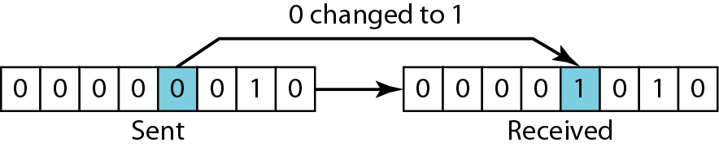
Figure 10.1 Single-bit error
10.‹#›
Notes:
‹#›

Slide 6
Note
A burst error means that 2 or more bits in the data unit have changed.
10.‹#›
Notes:
‹#›

Slide 7
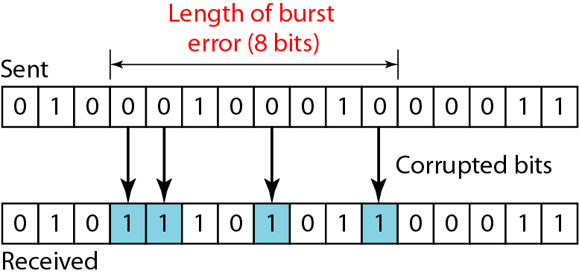
Figure 10.2 Burst error of length 8
10.‹#›
Notes:
‹#›

Slide 8
Redundancy
The central concept in error detection and correction
The redundant bits are added by the sender and removed by the receiver
Their presence helps the receiver to detect and correct corrupted bits
10.‹#›

Slide 9
Redundancy
Note
To detect or correct errors, we need to send extra (redundant) bits with data.
10.‹#›
Notes:
‹#›

Slide 10
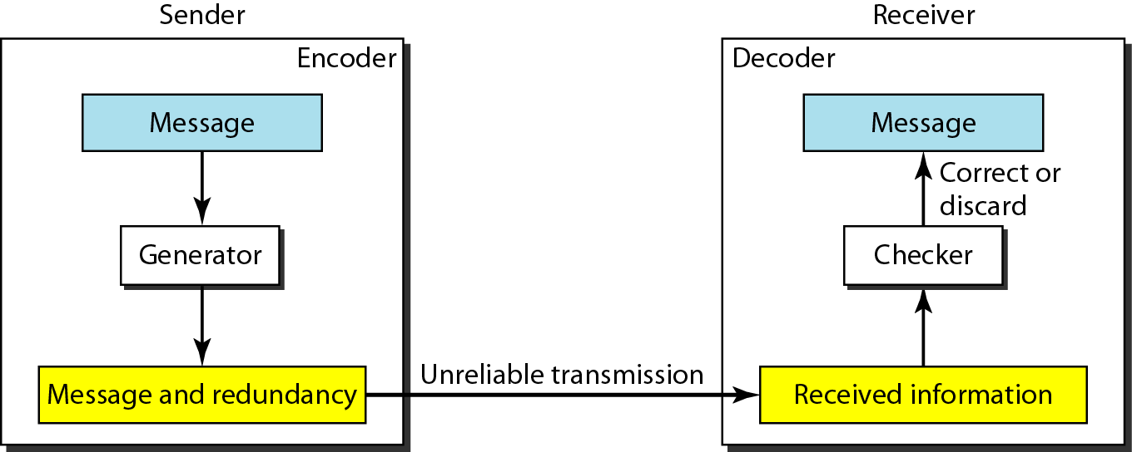
Figure 10.3 The structure of encoder and decoder
10.‹#›
Notes:
‹#›

Slide 11
Coding
Redundancy is achieved through various coding schemes
The coding schemes are divided into two broad categories
Block coding
Convolution coding
10.‹#›

Slide 12
Note
In this book, we concentrate on block codes; we leave convolution codes to advanced texts.
10.‹#›
Notes:
‹#›

Slide 13
Note
In modulo-N arithmetic, we use only the integers in the range 0 to N −1, inclusive.
10.‹#›
Notes:
‹#›

Slide 14
10-2 BLOCK CODING
In block coding, we divide our message into blocks, each of k bits, called datawords. We add r redundant bits to each block to make the length n = k + r. The resulting n-bit blocks are called codewords.
Topics discussed in this section:
Error Detection Error Correction Hamming Distance
Minimum Hamming Distance
10.‹#›
Notes:
‹#›

Slide 15
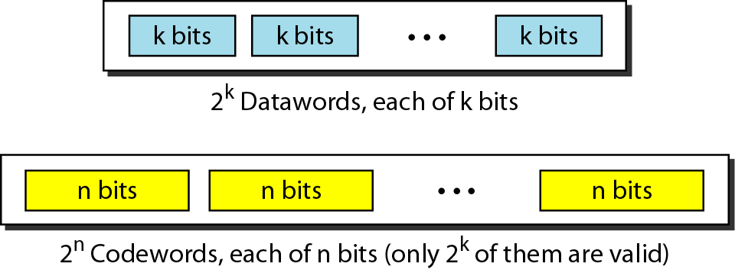
Figure 10.5 Datawords and codewords in block coding
10.‹#›
Notes:
‹#›

Slide 16
Example 10.1
The 4B/5B block coding discussed in Chapter 4 is a good example of this type of coding. In this coding scheme, k = 4 and n = 5. As we saw, we have 2^{k} = 16 datawords and 2^{n} = 32 codewords. We saw that 16 out of 32 codewords are used for message transfer and the rest are either used for other purposes or unused.
10.‹#›
Notes:
‹#›

Slide 17
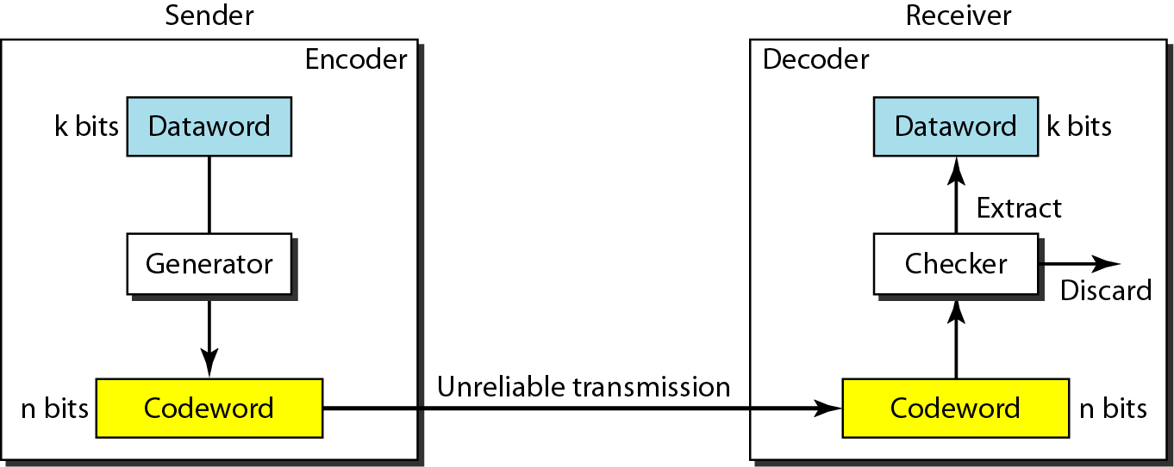
Figure 10.6 Process of error detection in block coding
10.‹#›
Notes:
‹#›

Slide 18
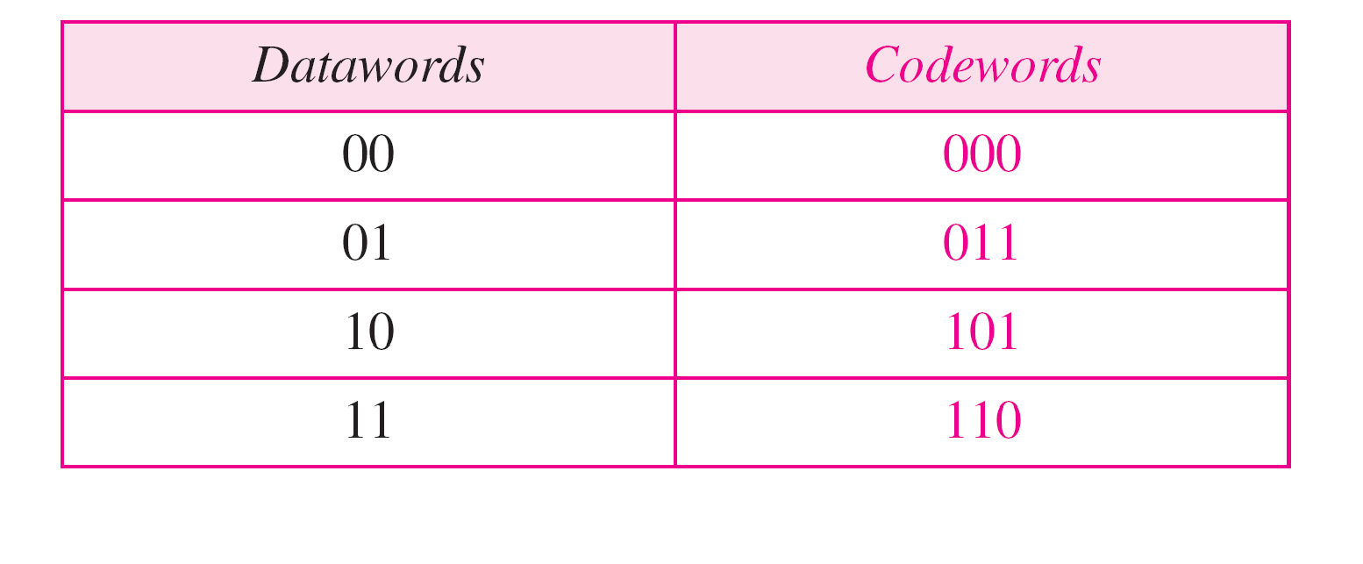
Table 10.1 A code for error detection (Example 10.2)
10.‹#›
Notes:
‹#›

Slide 19
Example 10.2
Let us assume that k = 2 and n = 3. Table 10.1 shows the list of datawords and codewords. Later, we will see how to derive a codeword from a dataword.
Assume the sender encodes the dataword 01 as 011 and
sends it to the receiver. Consider the following cases:
1. The receiver receives 011. It is a valid codeword. The receiver extracts the dataword 01 from it.
10.‹#›
Notes:
‹#›

Slide 20
Example 10.2 (continued)
2. The codeword is corrupted during transmission, and 111 is received. This is not a valid codeword and is discarded.
3. The codeword is corrupted during transmission, and 000 is received. This is a valid codeword. The receiver incorrectly extracts the dataword 00.
Thus two corrupted bits have made the error undetectable.
10.‹#›
Notes:
‹#›

Slide 21
Note
An error-detecting code can detect only the types of errors for which it is designed; other types of errors may remain undetected.
10.‹#›
Notes:
‹#›

Slide 22
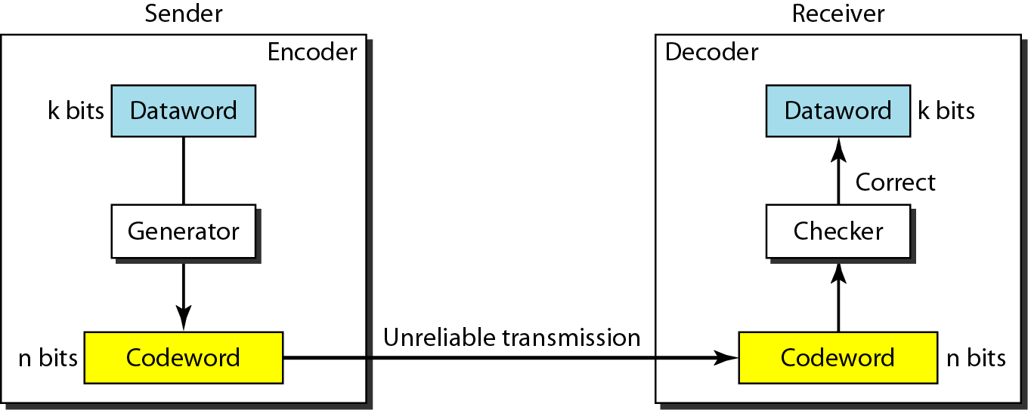
Figure 10.7 Structure of encoder and decoder in error correction
10.‹#›
Notes:
‹#›

Slide 23
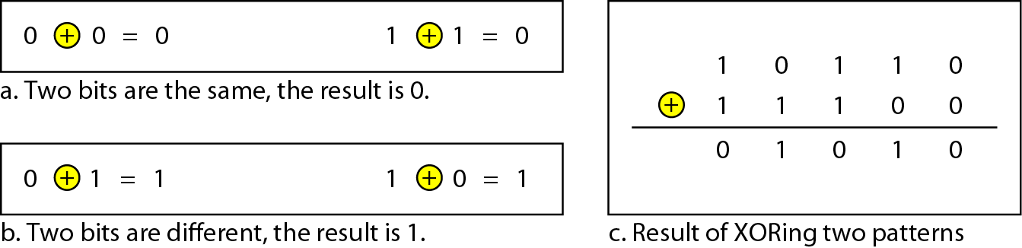
Figure 10.4 XORing of two single bits or two words
10.‹#›
Notes:
‹#›

Slide 24
Note
The Hamming distance between two words is the number of differences between corresponding bits.
10.‹#›
Notes:
‹#›

Slide 25

Example 10.4
Let us find the Hamming distance between two pairs of words.
1. The Hamming distance d(000, 011) is 2 because
2. The Hamming distance d(10101, 11110) is 3 because
10.‹#›
Notes:
‹#›

Slide 26
Note
The minimum Hamming distance is the smallest Hamming distance between all possible pairs in a set of words.
10.‹#›
Notes:
‹#›

Slide 27
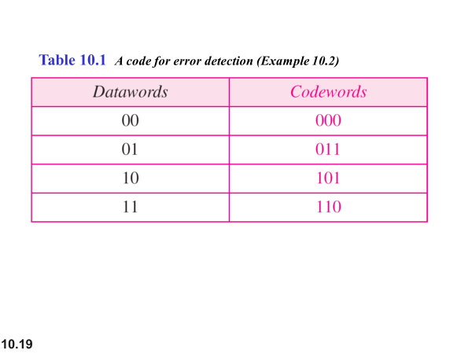
10.‹#›

Slide 28
There are four different codewords which can have 6 possible pairs
(000, 011)
(000, 101)
(000, 110)
(011, 101)
(011, 110)
(101.110)
10.‹#›

Slide 29
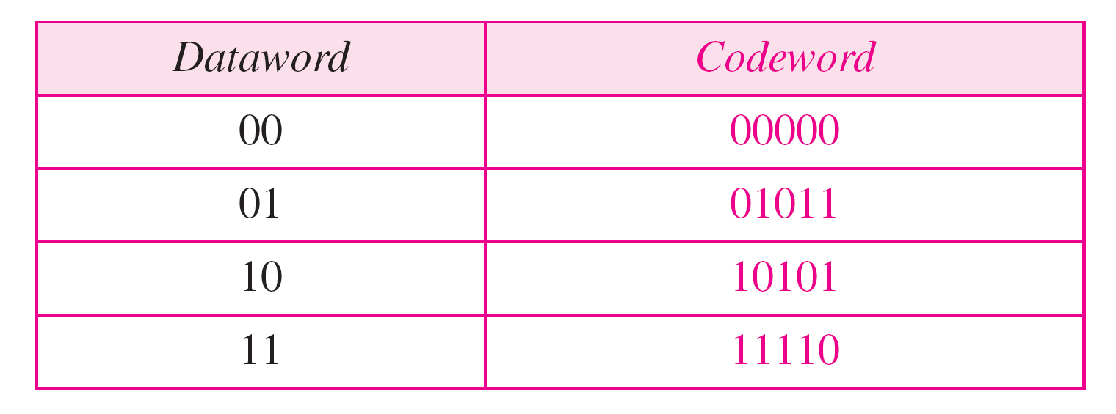
Table 10.2 A code for error correction (Example 10.3)
10.‹#›
Notes:
‹#›

Slide 30
Example 10.6
Find the minimum Hamming distance of the coding scheme in Table 10.2.
Solution
We first find all the Hamming distances.
The d_{min} in this case is 3.
10.‹#›
Notes:
‹#›

Slide 31
Note
To guarantee the detection of up to s errors in all cases, the minimum
Hamming distance in a block code must be d_{min} = s + 1.
10.‹#›
Notes:
‹#›

Slide 32
Note
To guarantee the correction of up to t errors in all cases, the minimum
Hamming distance in a block code must be d_{min} = 2t + 1.
10.‹#›
Notes:
‹#›

Slide 33
Example 10.9
A code scheme has a Hamming distance d_{min} = 4. What is the error detection and correction capability of this scheme?
Solution
This code guarantees the detection of up to three errors (s = 3), but it can correct up to one error. In other words, if this code is used for error correction, part of its capability is wasted. Error correction codes need to have an odd minimum distance (3, 5, 7, . . . ).
10.‹#›
Notes:
‹#›

Slide 34
10-4 CYCLIC CODES
Cyclic codes are special linear block codes with one extra property. In a cyclic code, if a codeword is cyclically shifted (rotated), the result is another codeword.
Topics discussed in this section:
Cyclic Redundancy Check Hardware Implementation Polynomials Cyclic Code Analysis
Advantages of Cyclic Codes Other Cyclic Codes
10.‹#›
Notes:
‹#›

Slide 35
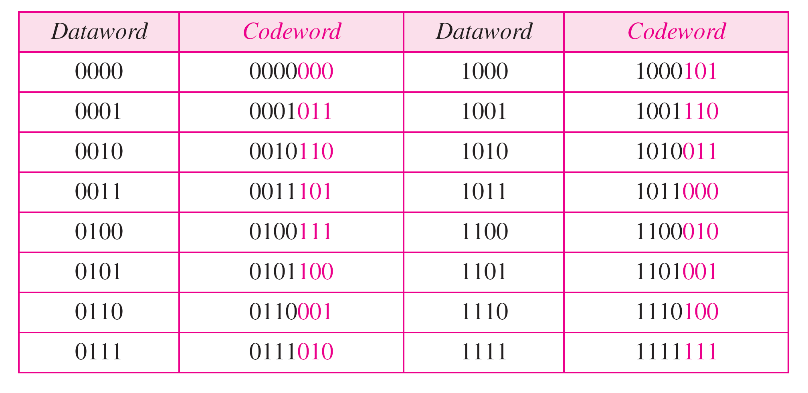
Table 10.6 A CRC code with C(7, 4)
10.‹#›
Notes:
‹#›

Slide 36
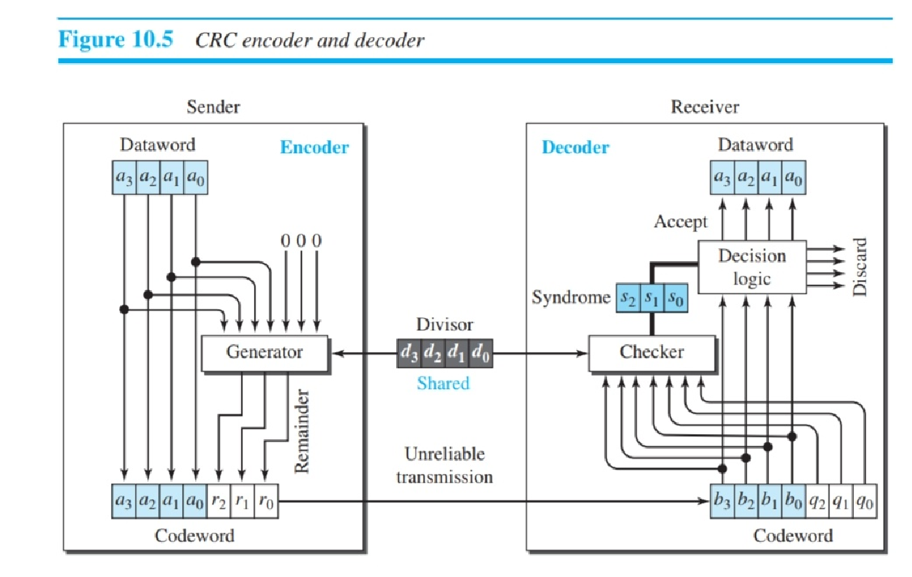
10.‹#›

Slide 37
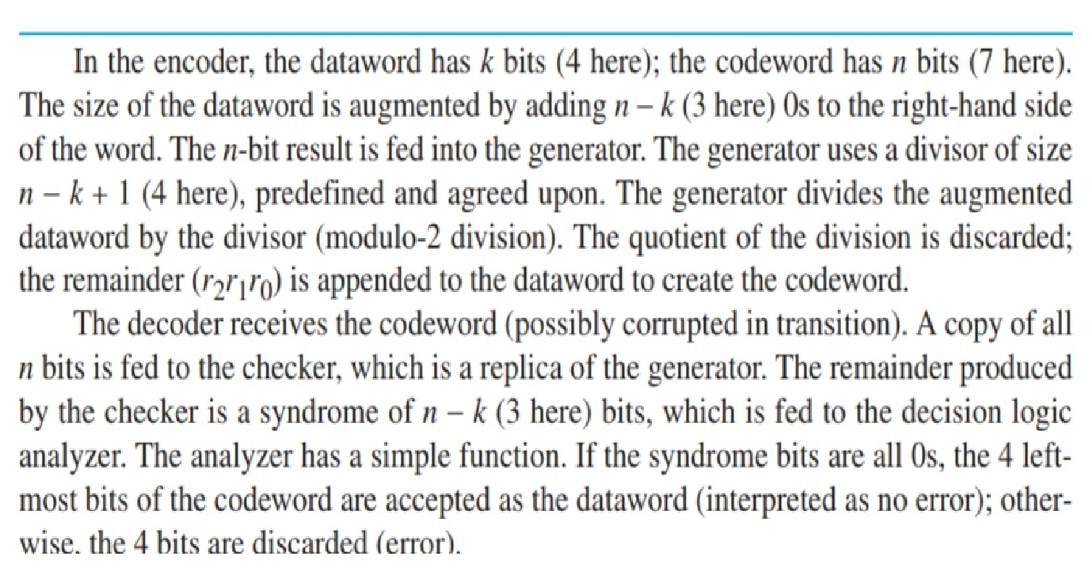
10.‹#›

Slide 38
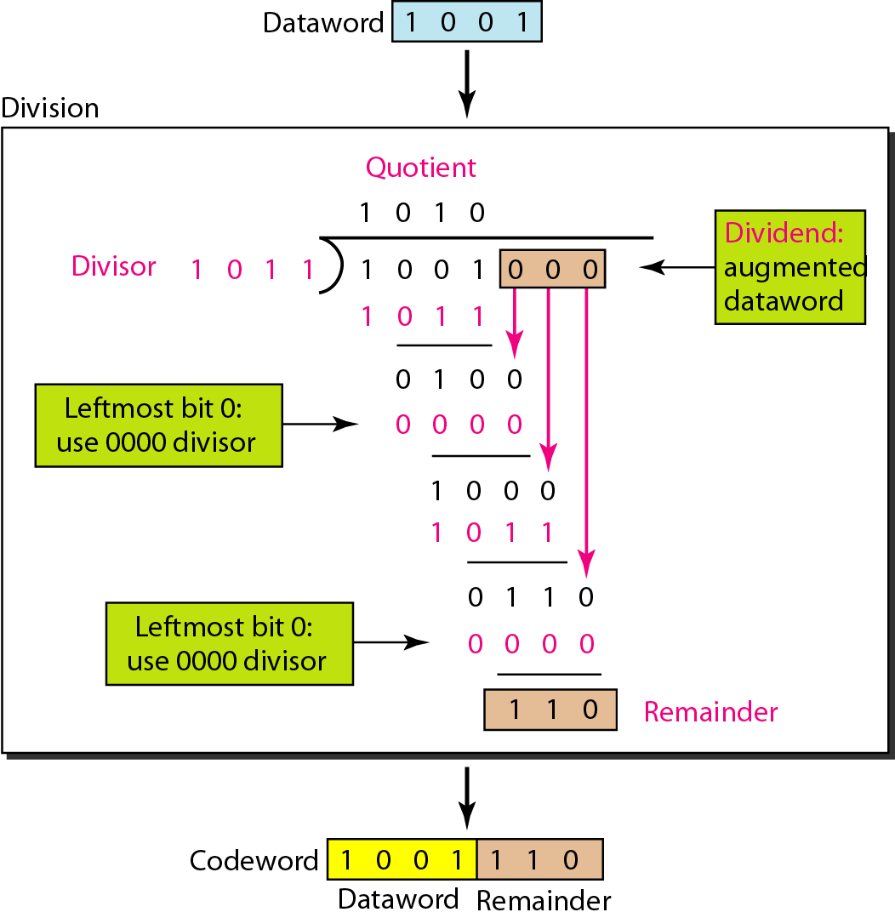
Figure 10.15 Division in CRC encoder
10.‹#›
Notes:
‹#›

Slide 39
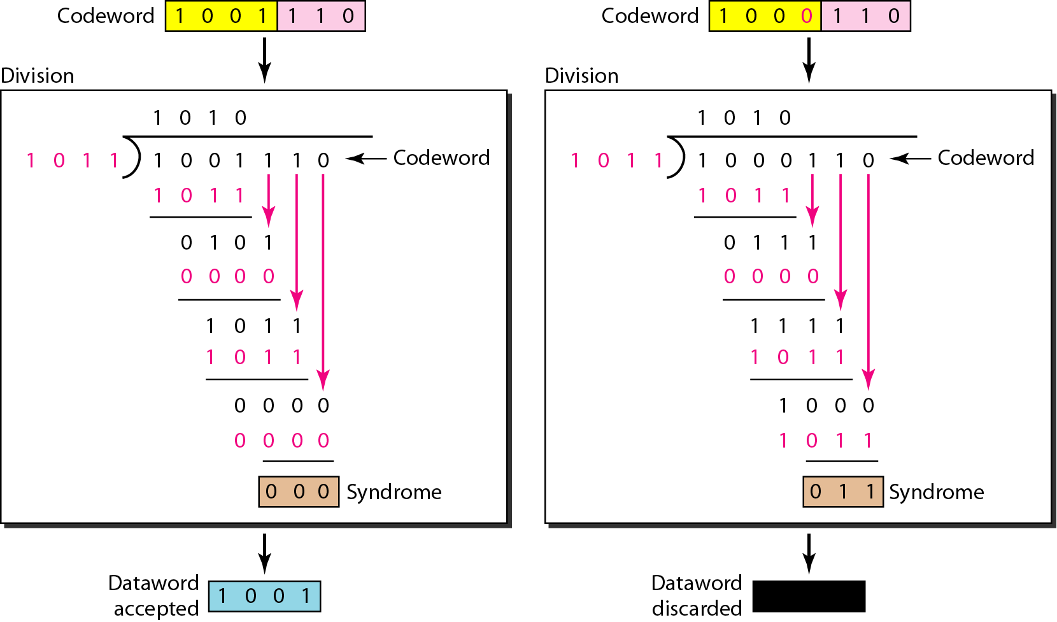
Figure 10.16 Division in the CRC decoder for two cases
10.‹#›
Notes:
‹#›

Slide 40
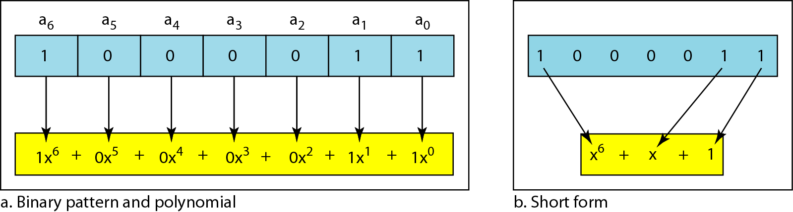
Figure 10.21 A polynomial to represent a binary word
10.‹#›
Notes:
‹#›

Slide 41
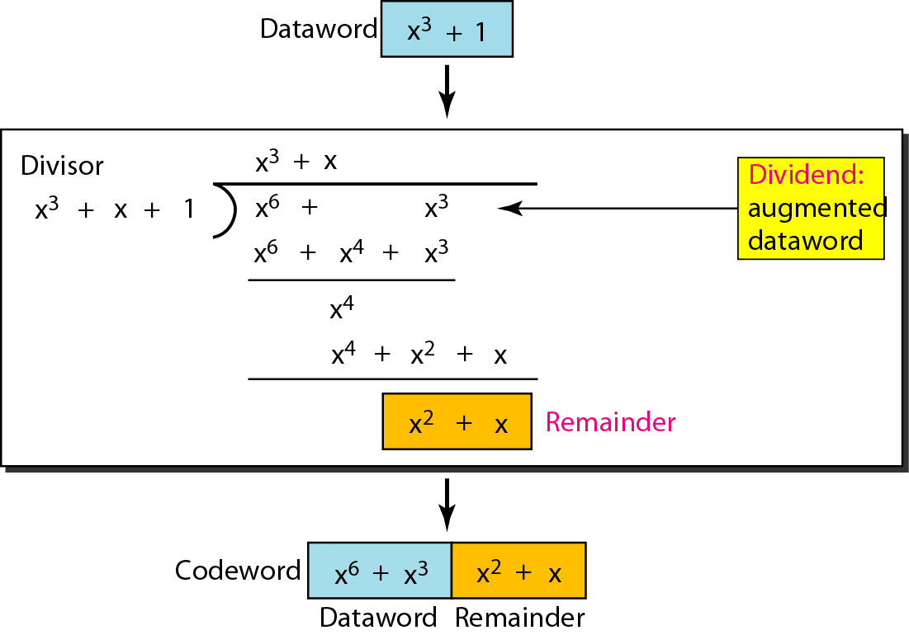
Figure 10.22 CRC division using polynomials
10.‹#›
Notes:
‹#›

Slide 42
Note
The divisor in a cyclic code is normally called the generator polynomial
or simply the generator.
10.‹#›
Notes:
‹#›

Slide 43
Dataword: d(x)
Syndrome: s(x)
Codeword: c(x)
Error: e(x)
Generator: g(x)
10.‹#›

Slide 44
Note
In a cyclic code,
If s(x) ≠ 0, one or more bits is corrupted.
If s(x) = 0, either
a. No bit is corrupted. or
b. Some bits are corrupted, but the decoder failed to detect them.
10.‹#›
Notes:
‹#›

Slide 45
Note
In a cyclic code, those e(x) errors that are divisible by g(x) are not caught.
10.‹#›
Notes:
‹#›

Slide 46
Note
If the generator has more than one term and the coefficient of x⁰ is 1, all single errors can be caught.
10.‹#›
Notes:
‹#›

Slide 47
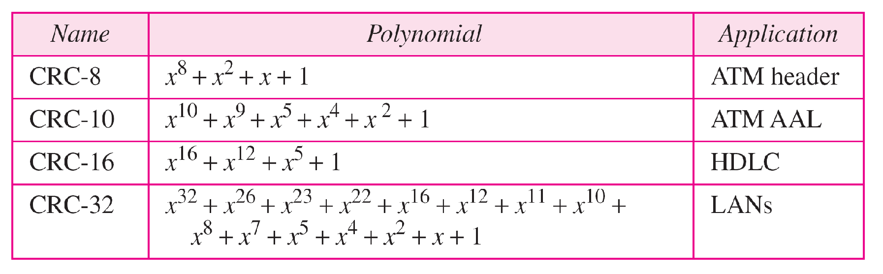
Table 10.7 Standard polynomials
10.‹#›
Notes:
‹#›

Slide 48
10-5 CHECKSUM
The last error detection method we discuss here is called the checksum. The checksum is used in the Internet by several protocols although not at the data link layer. However, we briefly discuss it here to complete our discussion on error checking
Topics discussed in this section:
Idea One’s Complement Internet Checksum
10.‹#›
Notes:
‹#›

Slide 49
Example 10.18
Suppose our data is a list of five 4-bit numbers that we want to send to a destination. In addition to sending these numbers, we send the sum of the numbers. For example, if the set of numbers is (7, 11, 12, 0, 6), we send (7, 11, 12, 0, 6, 36), where 36 is the sum of the original numbers. The receiver adds the five numbers and compares the result with the sum. If the two are the same, the receiver assumes no error, accepts the five numbers, and discards the sum. Otherwise, there is an error somewhere and the data are not accepted.
10.‹#›
Notes:
‹#›

Slide 50
Example 10.19
We can make the job of the receiver easier if we send the negative (complement) of the sum, called the checksum. In this case, we send (7, 11, 12, 0, 6, −36). The receiver can add all the numbers received (including the checksum). If the result is 0, it assumes no error; otherwise, there is an error.
10.‹#›
Notes:
‹#›

Slide 51
Example 10.20
How can we represent the number 21 in one’s complement arithmetic using only four bits?
Solution
The number 21 in binary is 10101 (it needs five bits). We can wrap the leftmost bit and add it to the four rightmost bits. We have (0101 + 1) = 0110 or 6.
10.‹#›
Notes:
‹#›

Slide 52
Example 10.21
How can we represent the number −6 in one’s complement arithmetic using only four bits?
Solution
In one’s complement arithmetic, the negative or complement of a number is found by inverting all bits. Positive 6 is 0110; negative 6 is 1001. If we consider only unsigned numbers, this is 9. In other words, the complement of 6 is 9. Another way to find the complement of a number in one’s complement arithmetic is to subtract the number from 2^{n} − 1 (16 − 1 in this case).
10.‹#›
Notes:
‹#›

Slide 53
Example 10.22
Let us redo Exercise 10.19 using one’s complement arithmetic. Figure 10.24 shows the process at the sender and at the receiver. The sender initializes the checksum to 0 and adds all data items and the checksum (the checksum is considered as one data item and is shown in color). The result is 36. However, 36 cannot be expressed in 4 bits. The extra two bits are wrapped and added with the sum to create the wrapped sum value 6. In the figure, we have shown the details in binary. The sum is then complemented, resulting in the checksum value 9 (15 − 6 = 9). The sender now sends six data items to the receiver including the checksum 9.
10.‹#›
Notes:
‹#›

Slide 54
Example 10.22 (continued)
The receiver follows the same procedure as the sender. It adds all data items (including the checksum); the result is 45. The sum is wrapped and becomes 15. The wrapped sum is complemented and becomes 0. Since the value of the checksum is 0, this means that the data is not corrupted. The receiver drops the checksum and keeps the other data items. If the checksum is not zero, the entire packet is dropped.
10.‹#›
Notes:
‹#›

Slide 55
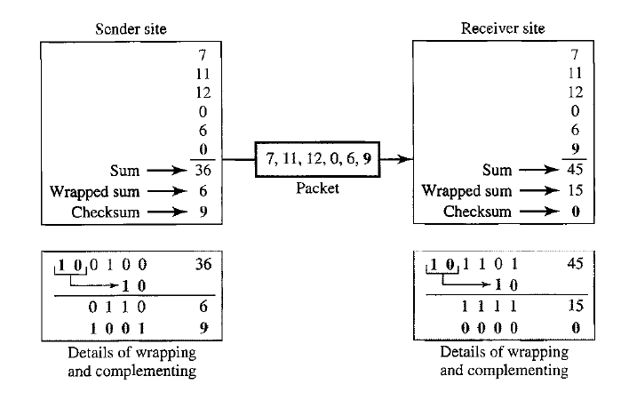
Figure 10.24 Example 10.22
10.‹#›

Slide 56
Internet Checksum
Note
Sender site:
1. The message is divided into 16-bit words.
2. The value of the checksum word is set to 0.
3. All words including the checksum are added using one’s complement addition.
4. The sum is complemented and becomes the checksum.
5. The checksum is sent with the data.
10.‹#›
Notes:
‹#›

Slide 57
Internet Checksum
Note
Receiver site:
1. The message (including checksum) is divided into 16-bit words.
2. All words are added using one’s complement addition.
3. The sum is complemented and becomes the new checksum.
4. If the value of checksum is 0, the message is accepted; otherwise, it is rejected.
10.‹#›
Notes:
‹#›

Slide 58
Example 10.23
Let us calculate the checksum for a text of 8 characters (“Forouzan”). The text needs to be divided into 2-byte (16-bit) words. We use ASCII (see Appendix A) to change each byte to a 2-digit hexadecimal number. For example, F is represented as 0x46 and o is represented as 0x6F. Figure 10.25 shows how the checksum is calculated at the sender and receiver sites. In part a of the figure, the value of partial sum for the first column is 0x36. We keep the rightmost digit (6) and insert the leftmost digit (3) as the carry in the second column. The process is repeated for each column. Note that if there is any corruption, the checksum recalculated by the receiver is not all 0s. We leave this an exercise.
10.‹#›
Notes:
‹#›

Slide 59
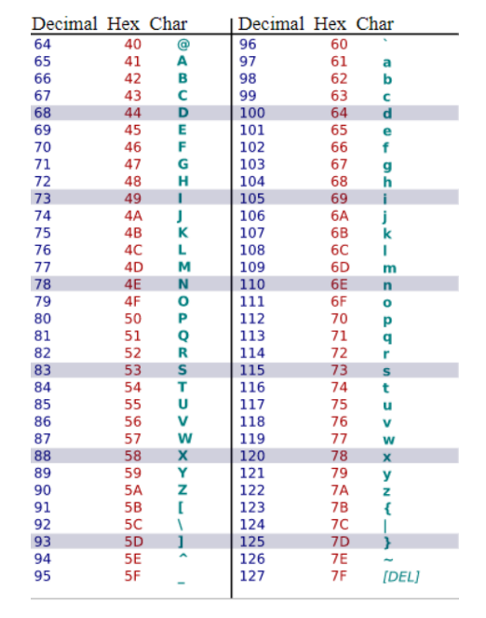
Appendix A

Slide 60
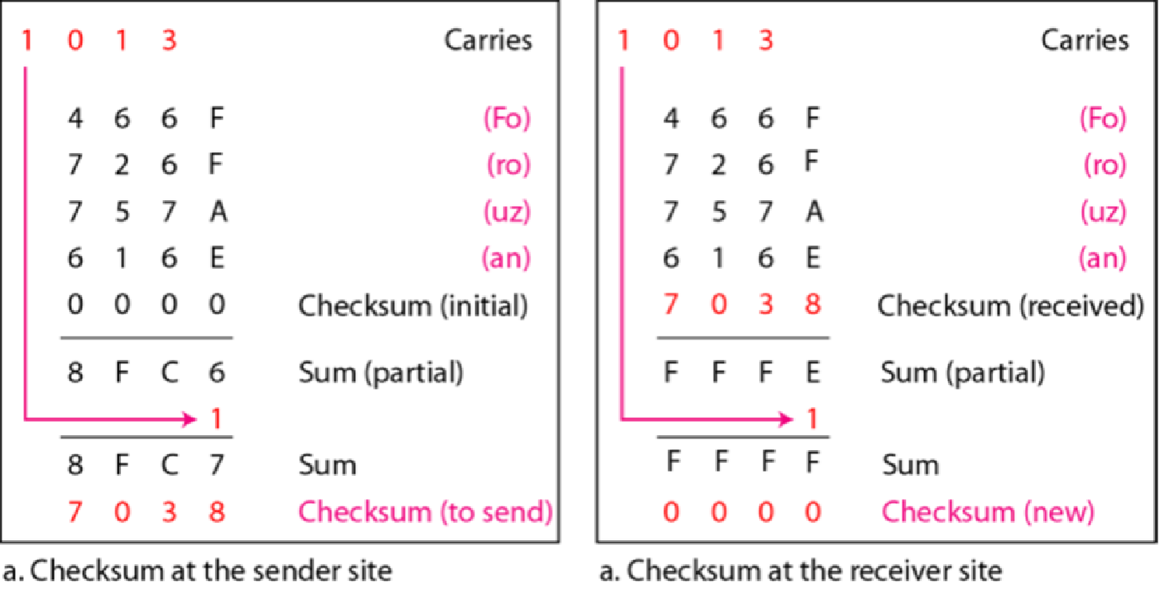
Figure 10.25 Example 10.23
10.‹#›
Notes:
‹#›

